Slide 1
Evolutionary STL Layouts: An application of the 2d Bin Packing Problem
Stuart Miller
Graduate Student, Computer Engineering
Missouri University of Science & Technology
CpE 5310 (Computational Intelligence)

Slide 2
Problem Statement
3D Printing becoming widely embraced
Laying out parts can be a time consuming process
Alignment
Fit on plate
Overlap
Humans often resolve layout conflicts by simple trial and error
Particular burden on maker space/shop/production-type operations
Need an automated solution

Slide 3
2D Bin Packing Problem/ Cutting Stock Problem
Optimization problem
Computational complexity is NP-hard
Problem consists of a list of parts (or “stock”)
Our problem will take .stl projections as input
Solution consist of multiple packing dimensions
Our solution will consist of lists for X and Y coordinates and rotation

Slide 4
Evolutionary Algorithm
Evolve a layout rather than determining one algorithmically
Allows for more flexibility
Easy to recombine/mutate simple lists of x, y, rot values
C++ implementation fast

Slide 5
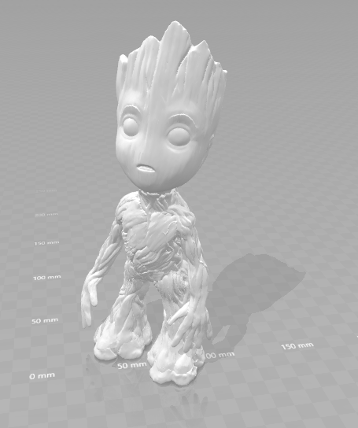
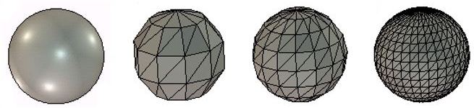

Problem Representation
Need to convert STL to a 2D projection
Discard Z value
Take the (X,Y) coordinates of each corner of the STL triangle mesh
Rounds these coordinates to discrete millimeter values
Fill area in between these points
Copy all filled (X,Y) values onto a single 2d array of Boolean values
https://www.solidsolutions.co.uk/Uploaded/Image/BLOG-PICS/Nick%20Jones/SOLIDWOKRS-Blog-3D-Printing-STL-Res-Type.JPG

Slide 6
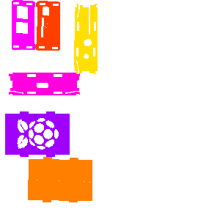
Problem Representation
Rotations
Manipulating graphics is a computationally-intensive process
Re-calculating a new rotation for every fitness evaluation is impractical
Pre-calculate all our rotations when processing the STL.
Restrictions
Another opportunity to save on computation time
Don’t always need 360° of rotation

Slide 7
Fitness Evaluation
Penalty system – invalid layouts are allowed, but penalized
Overlaps and out-of-bounds subtract points
Empty columns on the right side add points
Ideally results in a valid, compact layout

Slide 8
Genetic Algorithm Flow
Randomize Initial Population
name=rasbpi_layout
stl=./stl/rasbpi_1.stl
scale=1.0
stl=./stl/rasbpi_2.stl
scale=1.0
stl=./stl/rasbpi_3.stl
scale=1.0
stl=./stl/rasbpi_4.stl
scale=1.0
stl=./stl/rasbpi_5.stl
scale=1.0
stl=./stl/rasbpi_6.stl
scale=1.0
width=300
height=300
# Random generator seeding
# (0=static, 1=time-based)
seedType=1
seed=222223
# Termination test
# (0=evals, 1=gens, 2=best unchanged)
termTest=2
termTarget=300
mu=50
lambda=25
parentSelTournSize=25
survivorSelTournSize=25
crossovers=1
# Mutation
# (0=random, 1=creep)
mutationType=1
mutationRate=1.00
creepDist=20
rotationalRestriction=90
evals=10000
runs=30
Generate Children
Mutate Children
Calculate Fitness of Children
Add children to population
Reduce population
Run Termination Test

Slide 9
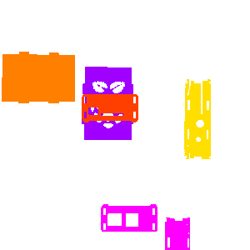
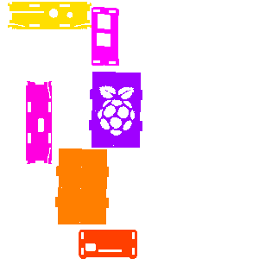
Best and Worst Outcomes
Initial Random
Run 10
Run 13

Slide 10
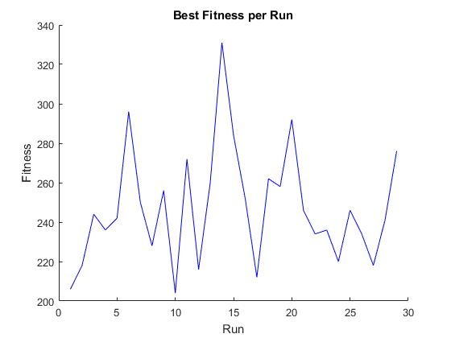
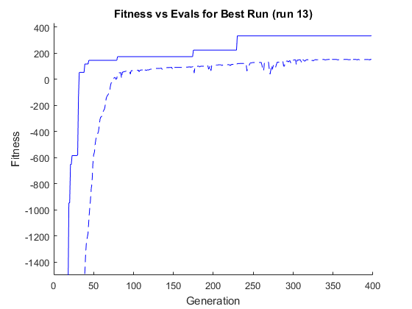
Graphical Analysis

Slide 11
Possible Future work
Allow direct export to slicers (difficult as most slicers are “black boxes”)
Add support for other popular file types (.obj)
Implement a multi-objective EA (optimize for length AND width)
Additional speed improvements
Repair function instead of penalties for invalidity

Slide 12
Live Demo

Slide 13
Questions?

